Slide 1


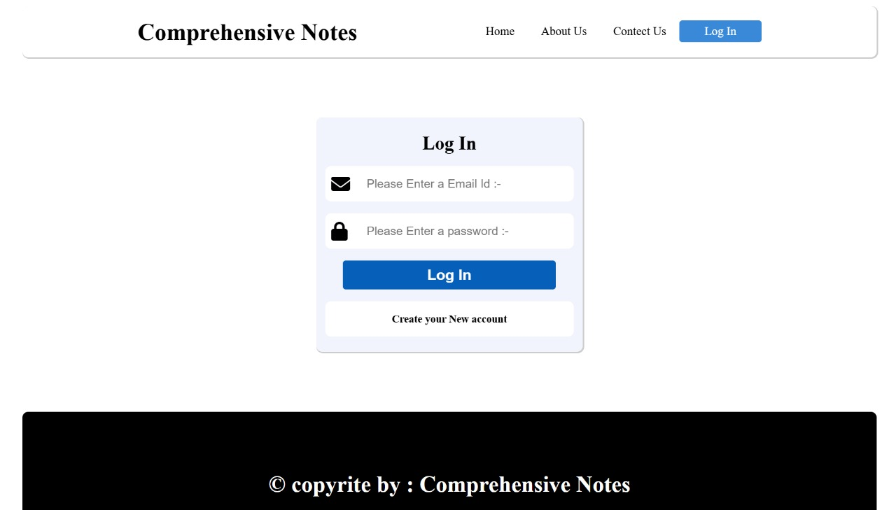
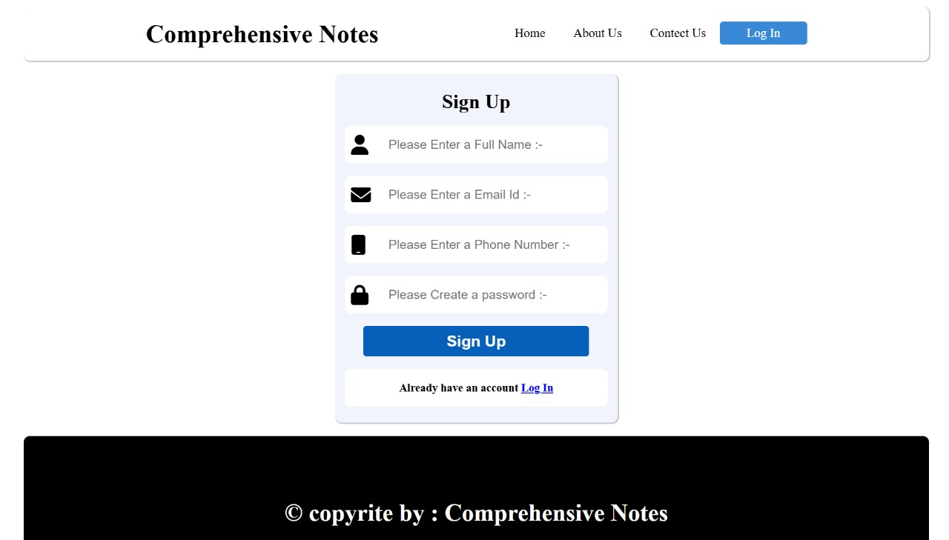
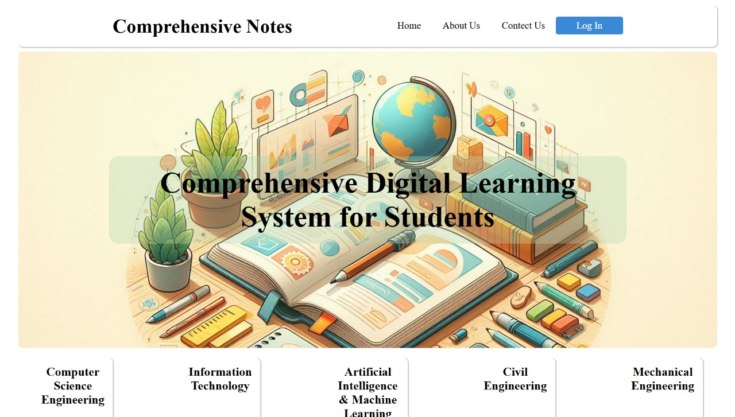
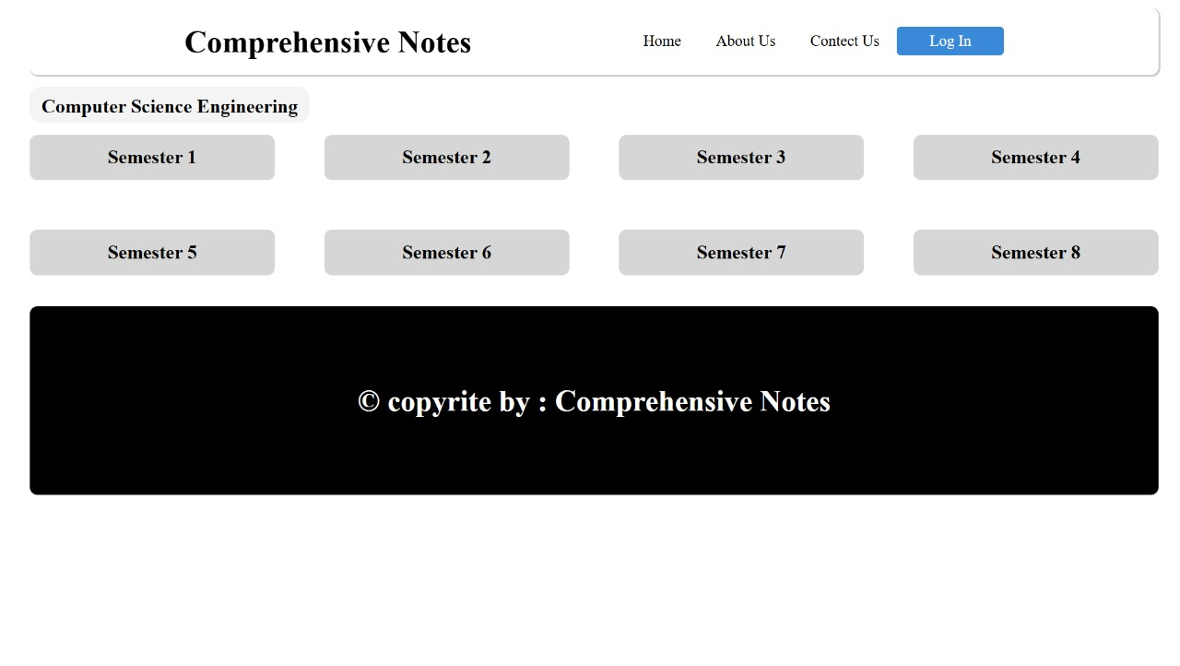
Comprehensive Digital Learning System
Atharv Sharna (0827IT233D02). Abhishek Rathore(0827IT233D01).
Jatin Rao(0827IT233D03), Ineesh Dubey (0827IT221064), Harsh Suryavanshi(0827IT221056).
Department Name, Acropolis Institute of Technology & Research, Indore
Session: Jul. – Dec. 2024
Abstract
Methodology
Results
The Comprehensive Digital Learning System for Students is a web-based platform designed to simplify access to reliable study materials through features like keyword-based search, peer-reviewed notes, and collaborative tools. Built with responsive design and a user-friendly interface, it enables seamless access across devices while fostering a community-driven learning environment. By automating content organization and review processes, the system enhances study efficiency and accessibility, addressing key challenges in modern education. Future advancements, such as AI-driven personalization, can further expand its impact on student learning.
Methodology
1. Data Collection and Organization
Develop a structured database to store study materials, user credentials, and metadata. Notes are categorized by subject, topic, and user ratings, enabling efficient retrieval and organization. This serves as the foundation for search and recommendation functionalities.
2. Keyword-Based Search and Filtering
Implement algorithms to allow users to search study materials using keywords. Filters are designed to sort notes by subject, rating, or relevance, ensuring users quickly find the most useful resources.
3. Peer Review and Collaboration Features
Create a peer-review system where users can rate, comment on, and discuss uploaded notes. This enhances content reliability and promotes collaboration by fostering community-driven interactions and feedback.
4. User Interface and Experience Design
Design a responsive, user-friendly interface accessible on desktops, tablets, and smartphones. The interface simplifies navigation, enabling users to upload notes, search for materials, and engage in discussions with minimal effort.
5. Testing and Optimization
Conduct rigorous unit and integration testing to validate the functionality of individual modules and their interactions. Optimize database queries, front-end performance, and back-end processing to ensure fast and seamless operation across devices.
6. Real-Time Note Accessibility
Implement real-time accessibility for uploaded notes, ensuring that users can immediately access newly added or updated content. This includes dynamic updates to filters and search results.
7. Scalability and Future Enhancements
Develop a scalable system architecture to support additional features, such as AI-driven personalized recommendations and gamification elements. Future iterations may also include a dedicated mobile application to further enhance accessibility.
Introduction
Introduction
Access to well-organized and reliable study materials is crucial for academic success.
Students often struggle to find comprehensive resources tailored to their curricula, leading to inefficiencies and disorganized study practices. Existing solutions, like scattered platforms or personal networks, fail to address this issue effectively and lack collaborative features.
The Comprehensive Digital Learning System for Students is a web-based platform designed to centralize and simplify access to study materials.
This platform leverages advanced web technologies and intuitive design to allow students to upload, search, and manage study notes effortlessly. Key features include keyword-based search, peer reviews, and collaboration tools like commenting and discussions.
The system ensures seamless functionality and a user-friendly interface, making it accessible to students of all technical skill levels. By fostering collaboration and promoting organized study practices, it empowers students to achieve their academic goals efficiently.
The Comprehensive Digital Learning System transforms traditional learning methods by ensuring that all students have access to quality resources, personalized learning experiences, and an inclusive educational environment.
These are some samples of how our website will look.
Conclusion
1. The Comprehensive Digital Learning System for Students provides an intuitive and user-friendly platform for accessing, sharing, and engaging with study materials.
2. It enhances the learning experience through features like efficient search algorithms, peer reviews, and personalized content organization.
3. The platform ensures seamless user experience by utilizing scalable technologies like Python (Django), SQLite/MySQL, and responsive web design.
4. Future enhancements such as AI integration, gamification, and a mobile app will further improve accessibility and engagement.
5. The project addresses the challenges of accessing quality study materials while fostering a community-driven environment for collaborative learning.
6. Ultimately, it provides an efficient and interactive solution for students to access and contribute to educational resources, transforming the way students interact with their learning materials.
Objectives
1. Develop an Efficient Note Retrieval System: Create an AI-driven search algorithm that optimizes note searches based on keywords, relevance, and subject, providing students with quick access to the most relevant study materials.
2. Foster Collaborative Learning: Integrate a peer-review system that allows users to rate, comment, promoting collaboration.
3. Design an Intuitive User Experience: Build a user-friendly, responsive interface using HTML5, CSS3, and Bootstrap, ensuring seamless navigation across devices for students of all technical skill levels.
Acknowledgement
Guided By: Prof Mahendra Verma
Project Coordinator: Prof. Monika Choudhary
Hod; Prof. Prashant Lakkadwala

